Slide 1
Git Your Database Under Control Block 1 of 4
Tonie Huizer
He/him
Consultant
Promicro

Slide 2




Tonie
LIVE Support by:
Peter Kruis
Huizer
He/him
DevOps consultant
I like to read, experiment, talk and write about software and the software development process.
The fun I experience in my job is the combination of people and technology.
Focus areas in my working life:
Software development
(Database) DevOps
Whisky
Promicro
@promicroNL
medium.com/promicro
www.promicro.nl

Slide 3

Welcome Thank you for choosing my pre-con!
Hands-On Lab

Slide 4
Introduction, Git basics
Version Control: what, why and how do we use it?
Treating Database as code
How to extract your database and what are the benefits of migrations
Branching strategies and conventions
With the database in Git, how do we collaborate and work in parallel
Automation and pipelines
Automate deploying database changes to different environments

Slide 5

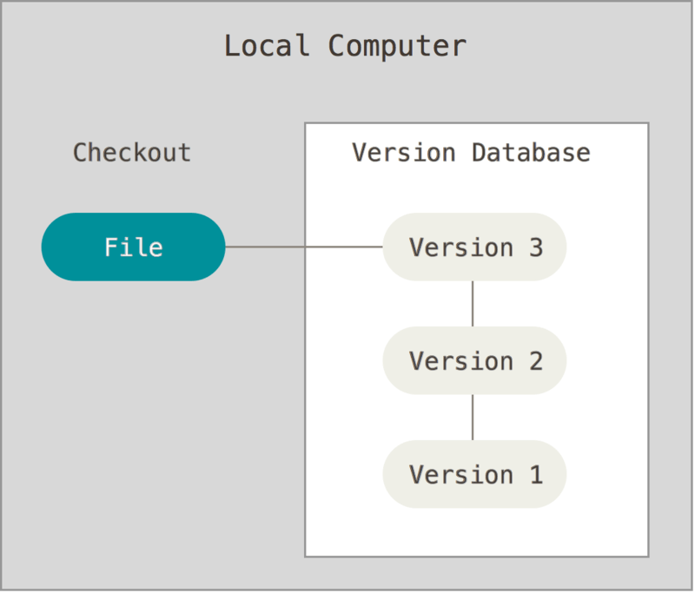
VCS, an introduction
Local
Shared Folder

Slide 6
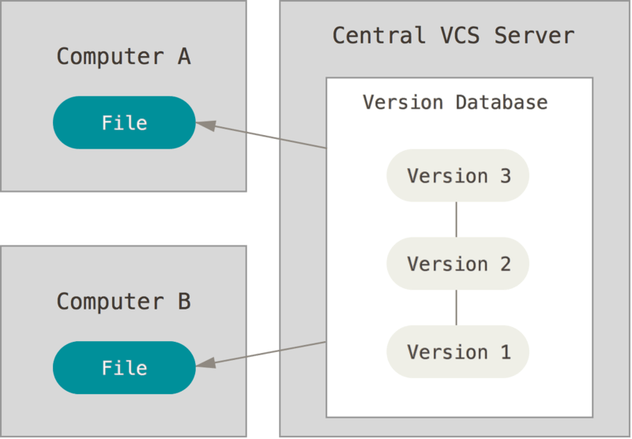
VCS, an introduction
Local
Central

Slide 7
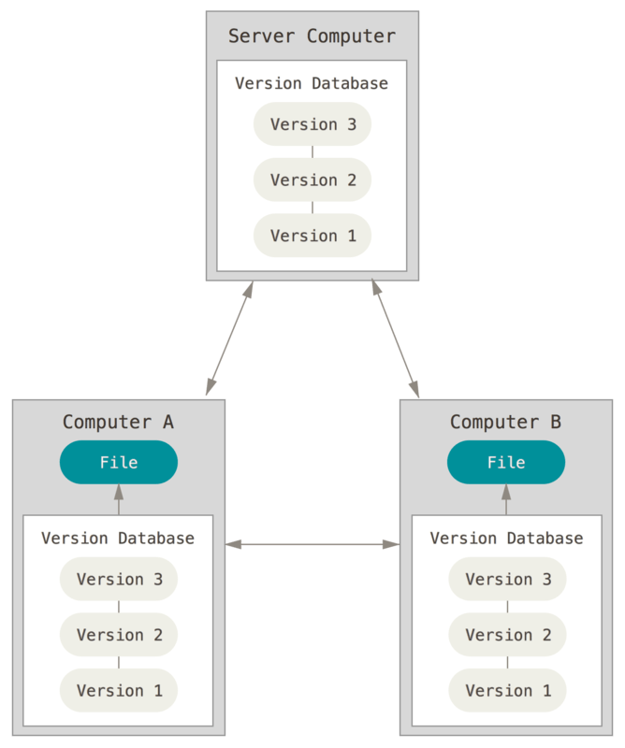

VCS, an introduction
Local
Central
Distributed

Slide 8
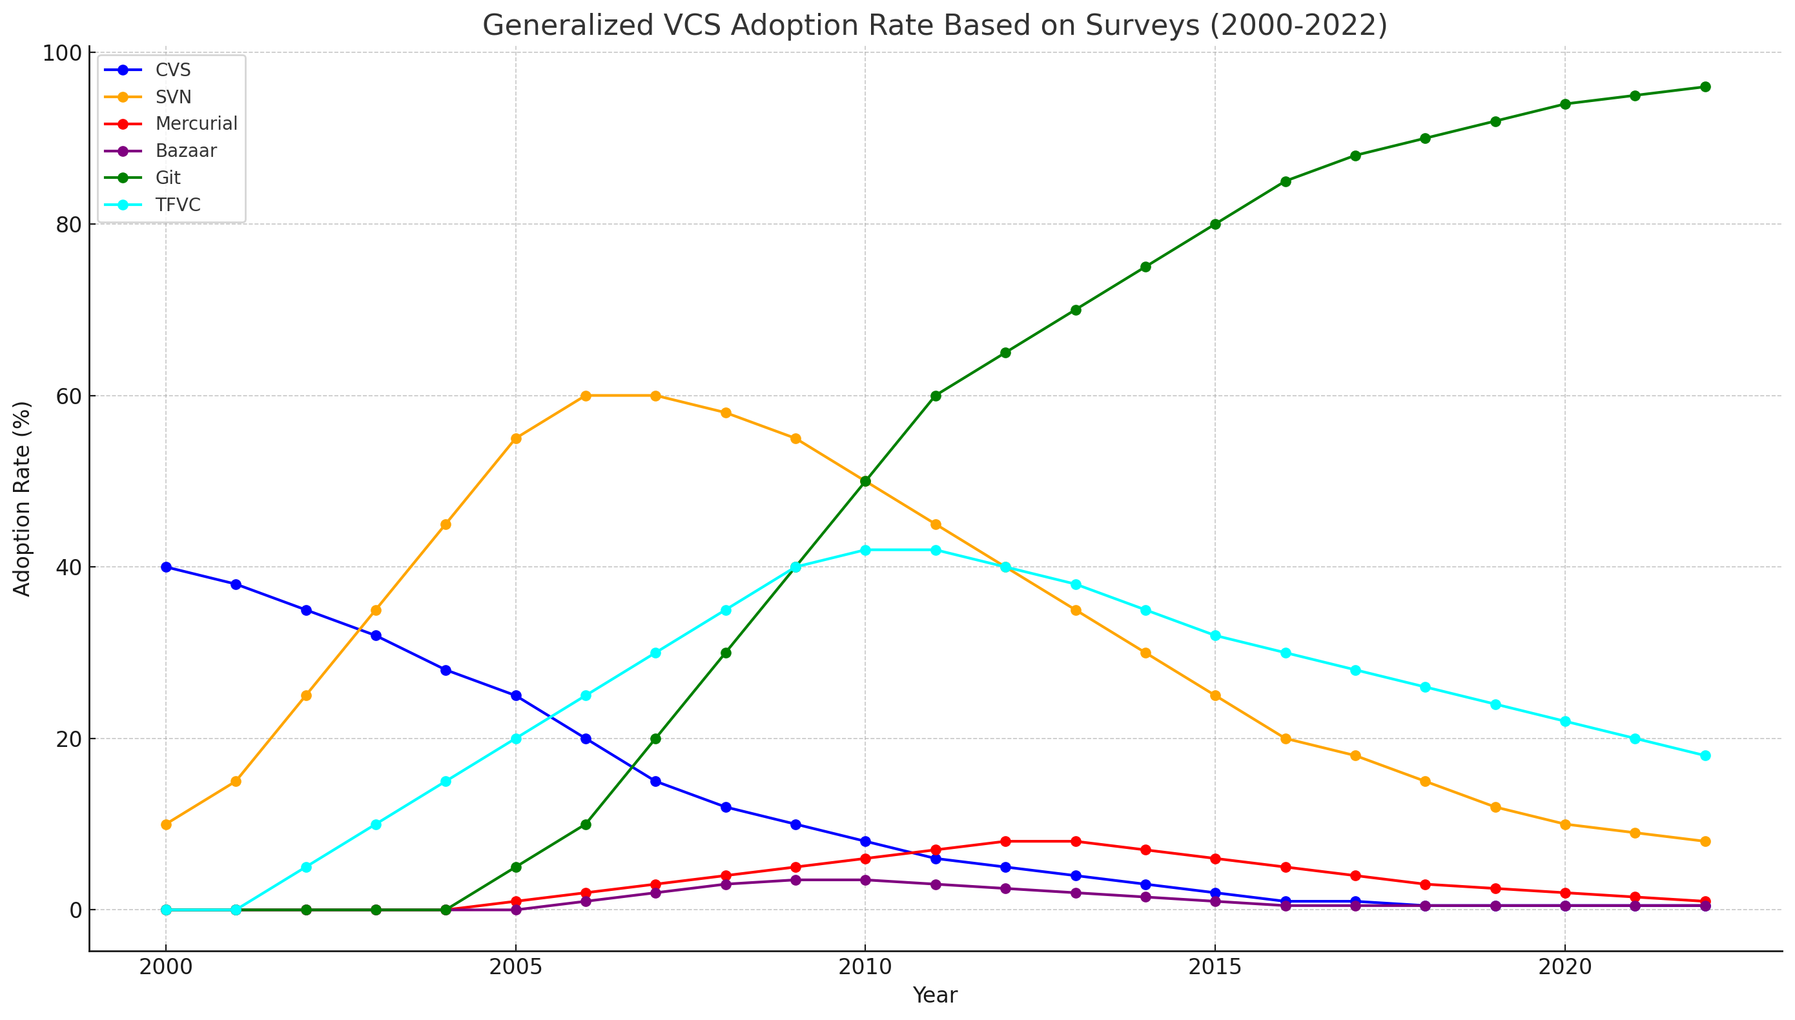
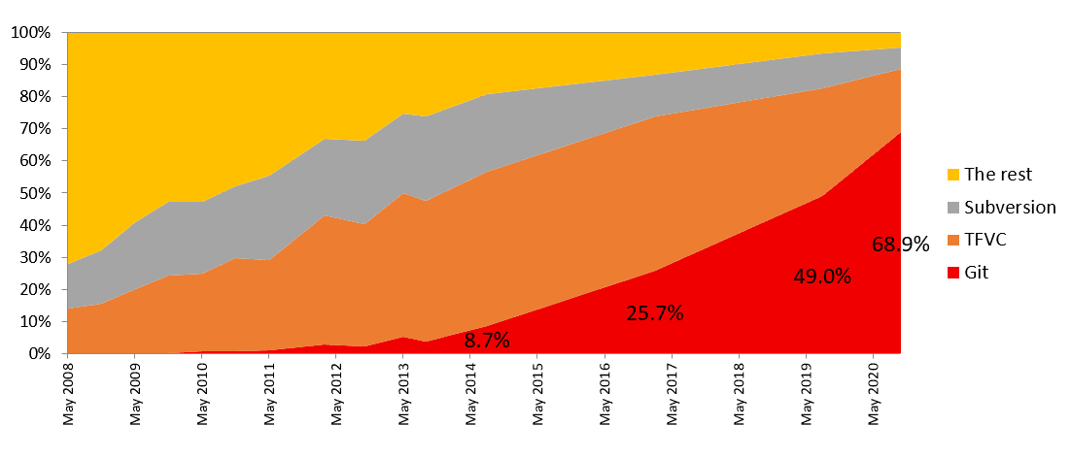
VCS, an introduction
Local
Central
Distributed

Slide 9

The history of Git
How it all started
Objectives & Philosophy
The impact of GitHub

Slide 10
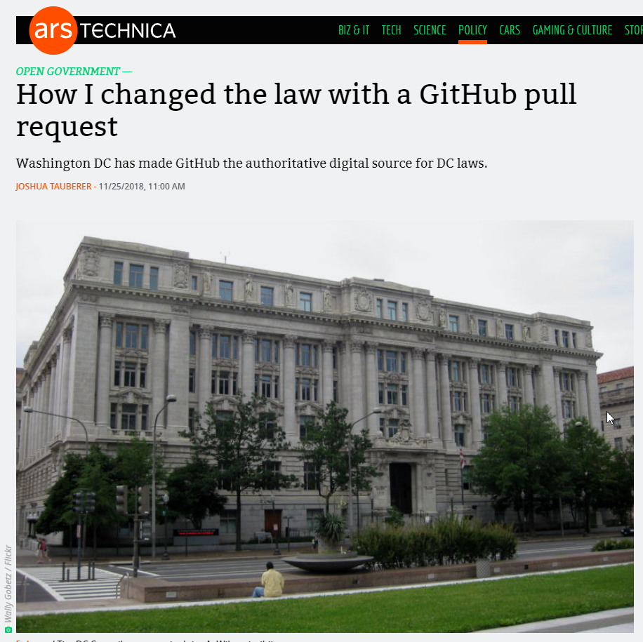
Git Beyond Software Code
Documentation
Scripts and Configuration files
Government and Regulatory Documents
Websites
Databases!

Slide 11
Git Beyond Software Code
Documentation
Scripts and Configuration files
Government and Regulatory Documents
Websites
Databases!

Slide 12
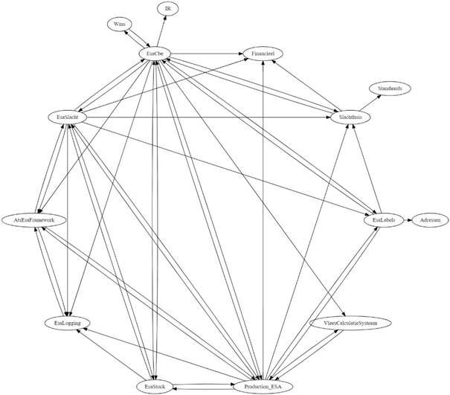

Why our team needed Git

Slide 13





To achieve: Database DevOps
Branch & Link task
Provision with clones
Develop
Provision with clones
2
Generate
Build
Approve
Start sprint
Create Pull request
Migration script
Test
Close Pull request and merge to main
Review schema changes
3
Deliver
Devs
Dedicated Dev DBs
1
Plan
Staging
Backlog tasks
Bugs,
Features
Requests
Drift check
4
Check Monitor
Operate
Production

Slide 14
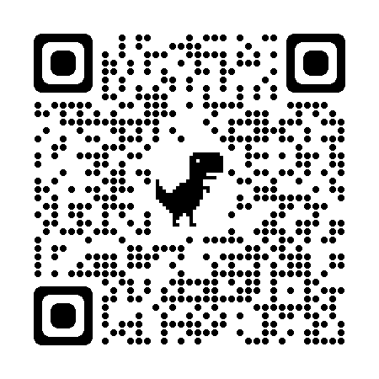
Computer Setup (Hands-on)
Install Git
Install VSCode
Create GitHub account

Slide 15
Basic Git Commands (Hands-On)
Getting Started with Git Commands

Slide 16

Forking a repo
local: main
clone
push
origin: main
fork
Pull Request
upstream: main

Slide 17

Forking a repo (Demo)
Fork a repo
Clone the repo
Make a change
Commit this change
Push and commit

Slide 18
Forking a repo
topic/b
topic/a
local: main
clone
push
origin: main
fork
Pull Request
upstream: main

Slide 19
Fill out a survey (Hands-On)
Fork a repo
Clone the repo
Make a change
Assessing Your Current Knowledge Level
Commit this change
Push and commit

Slide 20
Create a Pull Request (Hands-On)
Create a PR for your pushed work

Slide 21

Advanced Git Examples (Demo)
Exploring More Advanced Git Concepts

Slide 22



The end of this block

Slide 23
Introduction, Git basics
Version Control, what, why and how do we use it
Treating Database as code
How to extract your database and what are the benefits of migrations
Branching strategies and conventions
With the database in Git, how do we collaborate and work in parallel
Automation and pipelines
Automate deploying database changes to different environments

Slide 24
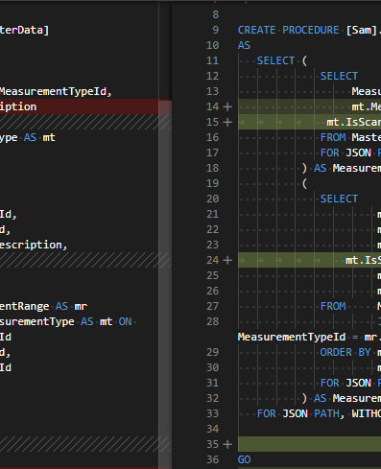
Databases as Code
Treating a Database like Code for…
Disaster Recovery
Documentation
Static Data
Migration Scripts
Schema Versioning

Slide 25


The result: Database DevOps
Branch & Link task
Provision with clones
Develop
Provision with clones
2
Generate
Build
Approve
Start sprint
Create Pull request
Migration script
Test
Close Pull request and merge to main
Review schema changes
3
Deliver
Devs
Dedicated Dev DBs
1
Plan
Staging
Backlog tasks
Bugs,
Features
Requests
Drift check
4
Check Monitor
Operate
Production

Slide 26



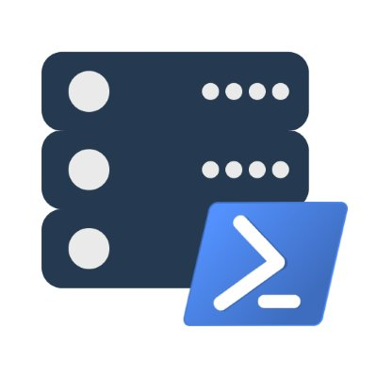


How to extract schema model as code?
Table1.sql
Table2.sql
Database
Git folder
View1.sql
Etc.sql
SSDT

Slide 27

Extract schema model (Demo)
SSDT

Slide 28
Put the database in Git (Hands-On)
Pre-req: Get a database running (*
Add extracted code to repo
Commit and push to remote
Create PR

Slide 29
Change the db and commit (Hands-On)
Make a change in the database
Extract the schema again
Use git diff to see changes
Commit and push to remote

Slide 30
Extract schema model (Hands-on)
SSDT

Slide 31
Put the database in Git (Hands-On)
Pre-req: Get a database running (*
Add extracted code to repo
Commit and push to remote
Create PR

Slide 32
Change the db and commit (Hands-On)
Make a change in the database
Extract the schema again
Use git diff to see changes
Commit and push to remote

Slide 33

Next: Database Migrations
What vs. How / Create vs. Alter
Consistent deployments to versioned DB’s
Use automation

Slide 34
Types of migrations
Stated based:
Source
Target
SSDT

Slide 35
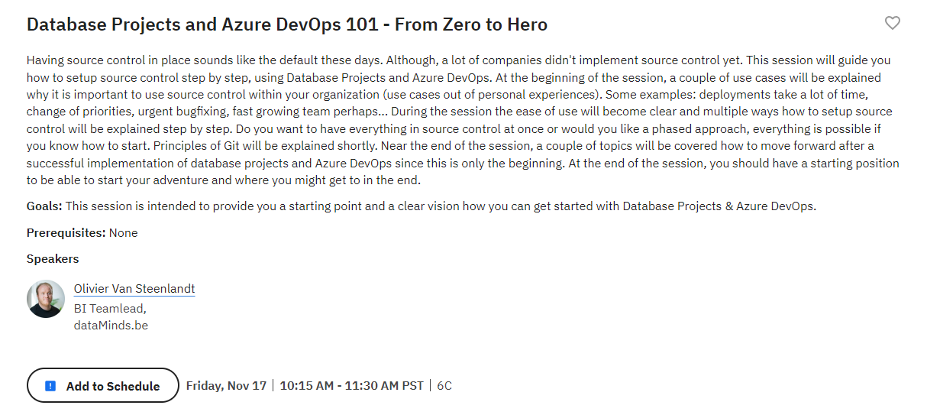
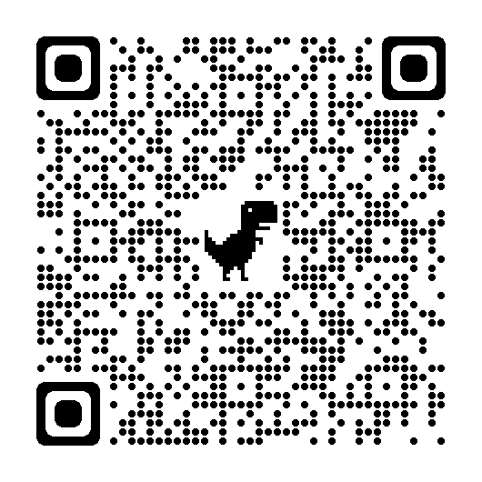

Slide 36
Types of migrations
Stated based
Migrations based:
Baselining: Set a starting point.
Generate subsequent migrations from this baseline
Target
Source

Slide 37

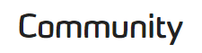
How to create migrations? (Demo)
SSDT
OpenDBDiff

Slide 38
Migration creation (Demo)
Create baseline
Make a change
Create a migration
Apply migrations to another DB
Commit and push to remote
Create PR

Slide 39
How to create migrations? (Hands-on)
OpenDBDiff

Slide 40
Migration creation (Hands-on)
Create baseline
Make a change
Create a migration
Apply migrations to another DB
Commit and push to remote
Create PR

Slide 41
The end of this block

Slide 42
Introduction, Git basics
Version Control, what, why and how do we use it
Treating Database as code
How to extract your database and what are the benefits of migrations
Branching strategies and conventions
With the database in Git, how do we collaborate and work in parallel
Automation and pipelines
Automate deploying database changes to different environments

Slide 43


The result: Database DevOps
Branch & Link task
Provision with clones
Develop
Provision with clones
2
Generate
Build
Approve
Start sprint
Create Pull request
Migration script
Test
Close Pull request and merge to main
Review schema changes
3
Deliver
Devs
Dedicated Dev DBs
1
Plan
Staging
Backlog tasks
Bugs,
Features
Requests
Drift check
4
Check Monitor
Operate
Production

Slide 44

Branching & Strategy
Why?
What?
Branching strategy

Slide 45
Trunk based development
No branches, direct in main
To protect main:
Make small change, frequent
Implement feature flags
Use Continuous Integration

Slide 46
Trunk based development
local: main
clone
push
main

Slide 47
Git Flow
Two long livings branches:
Main - stable production-ready code
Develop – here all development takes place
Short living branches: feature, release, and hotfix
Merge release, hotfix back in main and develop

Slide 48
Git flow in action
feature/b
feature/a
develop
Release/v1
hotfix/v1
main
Version 1.0
Version 1.1

Slide 49
Release flow
Short living topics
Main branch always in release state
Hotfix the release, cherry pick main

Slide 50
Release flow in action
topic/b
topic/a
topic/c
main
hotfix/s98
release/s97
release/s98

Slide 51
Branching Practice (Demo)
Creating branches
Making changes in a branch
Merging
Resolve merge conflicts

Slide 52
Branching Practice (Hands-on)
Creating branches
Making changes in a branch
Merging
Resolving merge conflicts

Slide 53
Create a branch naming convention
Topic / hotfix <branch category>/<hot fixed release>-<TicketId>-PascalCasingDescription
hotfix/s100-mms12220-FireFighting
topic/mms12345-MyDescription
Release branch <branch category>/<unique identification>
release/s100

Slide 54
The result: Database DevOps
Branch & Link task
Provision with clones
Develop
Provision with clones
2
Generate
Build
Approve
Start sprint
Create Pull request
Migration script
Test
Close Pull request and merge to main
Review schema changes
3
Deliver
Devs
Dedicated Dev DBs
1
Plan
Staging
Backlog tasks
Bugs,
Features
Requests
Drift check
4
Check Monitor
Operate
Production

Slide 55
Pull Requests (demo)
What?
How?
Pull request work flow

Slide 56
Pull Requests (Hands-on) [EXTRA]
Configure PR workflow:
Add branch policies
Configure release pipeline
Use the workflow
Make PR
See it in action

Slide 57
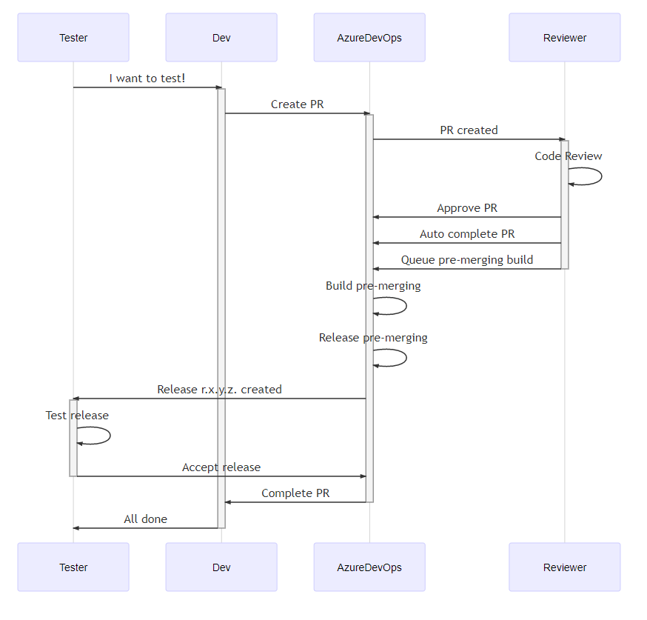
Consultant

Slide 58
The end of this block

Slide 59

Automation & pipelines
Automate repetitive tasks
Automate delivery processes
Release artifacts to different environments

Slide 60

The result: Database DevOps
Branch & Link task
Provision with clones
Develop
Provision with clones
2
Generate
Build
Approve
Start sprint
Create Pull request
Migration script
Test
Close Pull request and merge to main
Review schema changes
3
Deliver
Devs
Dedicated Dev DBs
1
Plan
Staging
Backlog tasks
Bugs,
Features
Requests
Drift check
4
Check Monitor
Operate
Production

Slide 61
Automation & Pipelines (demo)
Live demo
Production system
Azure DevOps

Slide 62
Automate repetitive tasks
Standardize the process
Use pipelines, but first…
Start local to automate (PowerShell)
Use verbose logging

Slide 63
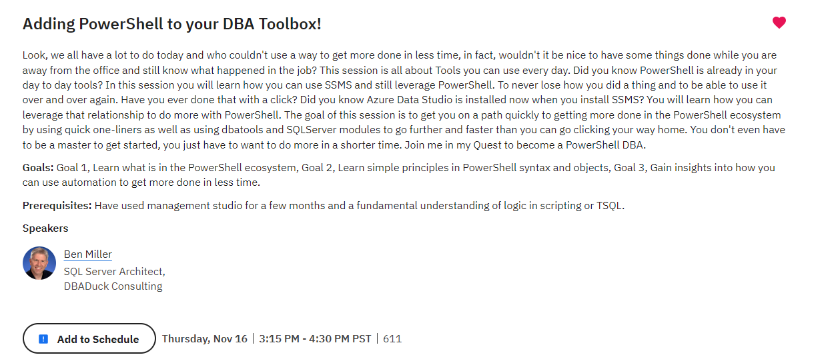
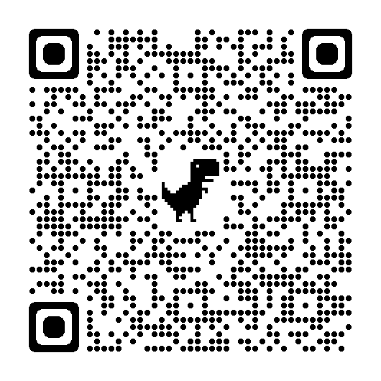

Slide 64
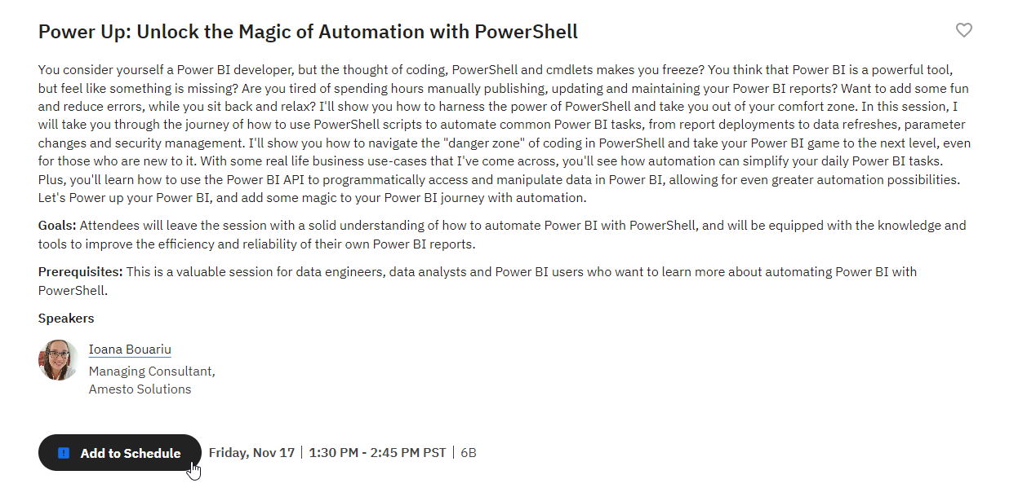
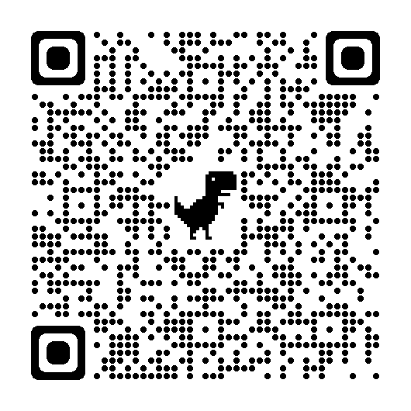

Slide 65
YAML
YAML Ain’t Markup Language
Indents, spaces, please look careful
https://www.yamllint.com/

Slide 66
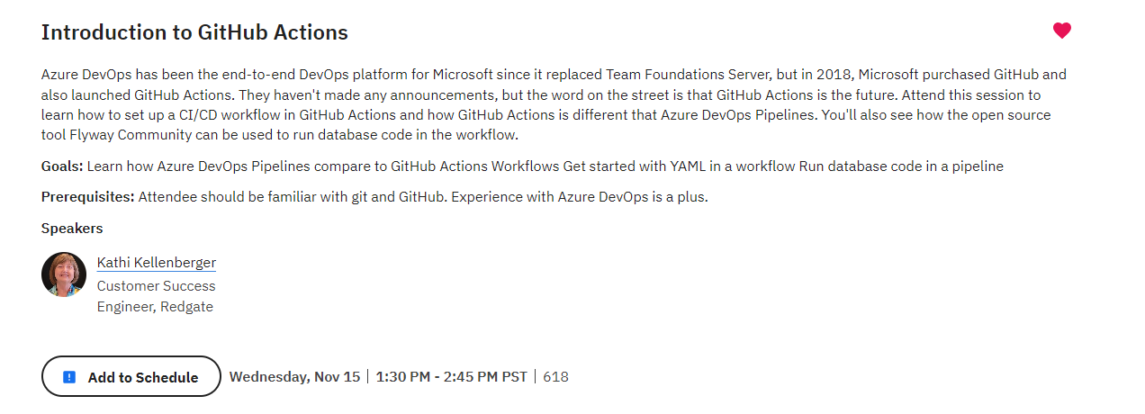
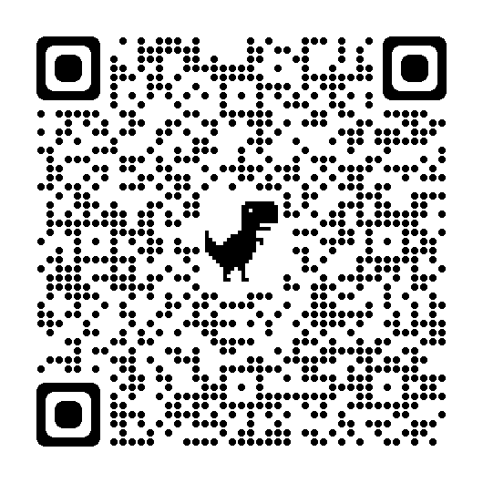

Slide 67

Recap + Takeaways
Have you accomplished your goals today?
Questions?

Slide 68
Tonie Huizer
@promicroNL
medium.com/promicro
www.promicro.nl

Slide 69


